Slide 1
Test Driven Development
What is TDD
The Basic Cycle
Fundamental Principles
Test First vs Test Last
Advantages of TDD
Challenges / Limitations
Testing Tools - Recommendations
TDD Examples [Test-Code-Refactor]
Mocking with Mockito
TDD Acceptance Testing
Legacy Code – TDD Approach

Slide 2
“If you can’t write a test for what you are about to code, then you shouldn’t even be thinking about coding”

Slide 3
What is TDD
TDD is the process of writing unit test to confirm precisely what production code you need to implement.
Each new test defines the new behaviour of the software to be implemented.
Also developing our production code through test helps to keep the design of our code clean.
We can access this test in isolation of the rest of the system.

Slide 4
What is TDD
In TDD, the test we write form a document describes all the features and functions of the system. Thus Unit Tests act as a functional definition of the code.
Each test describes the discrete behaviour of the system and each developer gets an insight into our code and deeper understanding of the code.
In TDD, we refer to this test as living documentation, so, as long as test as passing it is always correct. This is in contrast with the external documentation, that is completely disconnected from the code.

Slide 5
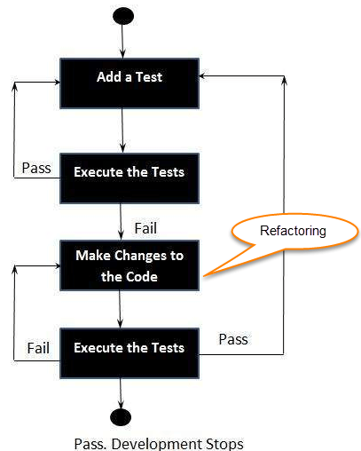
The Basic Cycle

Slide 6
Fundamental Principles
Think about what you are trying to do.
Follow the TDD Cycle
Never write new functionality without a Failing Test
Continually make Small, Incremental changes.
Keep the system running at all times.
  No one can make a change that breaks the system
  Failures must be address immediately.

Slide 7
Test First vs Test Last
Pick a piece of functionality.
Write a test that expresses a small task that fails.
Write production code until test passes
Rework code until all tests pass.
Repeat.
Pick a piece of functionality
Write production code that implements entire functionality.
Write tests to validate all functionality
Run all tests
Rework code until all tests pass.

Slide 8
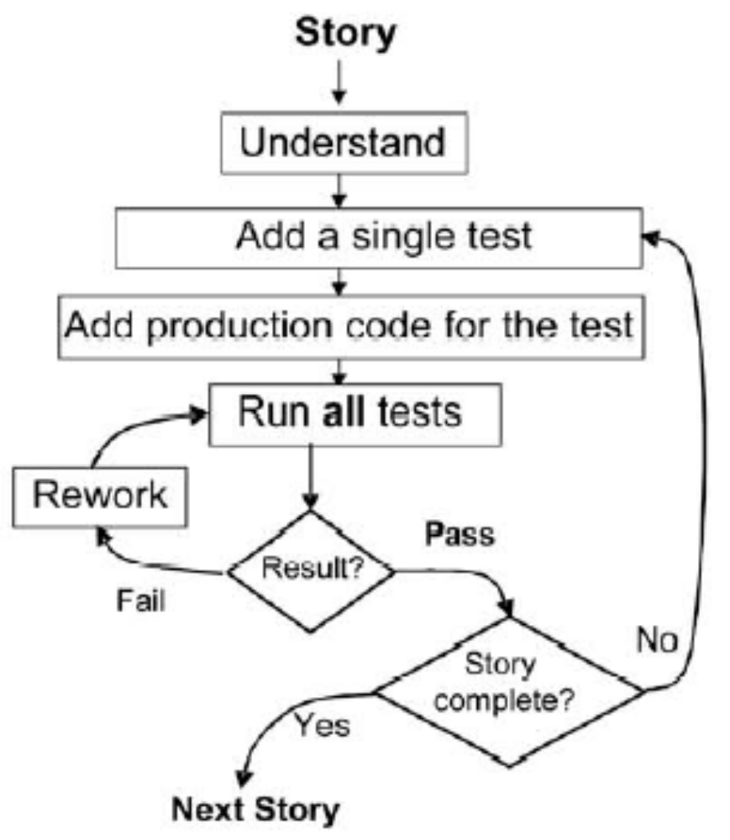
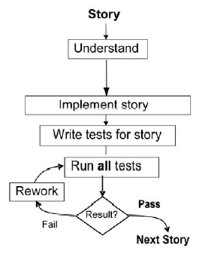
Test First vs Test Last
[1]

Slide 9
Advantages of TDD
Instant Feedback
Better development practices.
Quality Assurance
Reduces Rework effort.

Slide 10
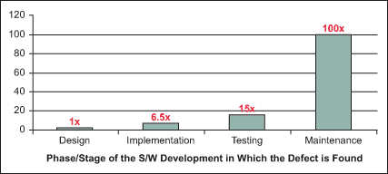
Cost of Change

Slide 11
Challenges
Requires a different mindset.
It takes a lot of time and effort which creates a sense of slow development.
TDD often doesn't include an upfront design. TDD focus on the implementation and less on the logical structure.
Difficult to test GUIs, Persistence, Web services. It requires mock objects.
Difficult to do TDD with legacy code.

Slide 12
Testing Tools - Recommendations
Unit Test Framework – Junit, TestNG
Mocking Framework – Mockito
Automated Build Tool - Maven
Acceptance Test Framework – Selenium(Web), SOAP UI(Web Services), Cucumber
Continuous Integration – Jenkin

Slide 13
Test Doubles
A Test Double is an object
  That looks like the real thing from outside
  Executes faster
  Is easier to develop and maintain.
Test doubles are used for two types of testing
  State based testing
  Interaction based testing

Slide 14
Test Doubles
We have three types of Test Doubles.
  Stubs
  Fakes
  Mocks

Slide 15
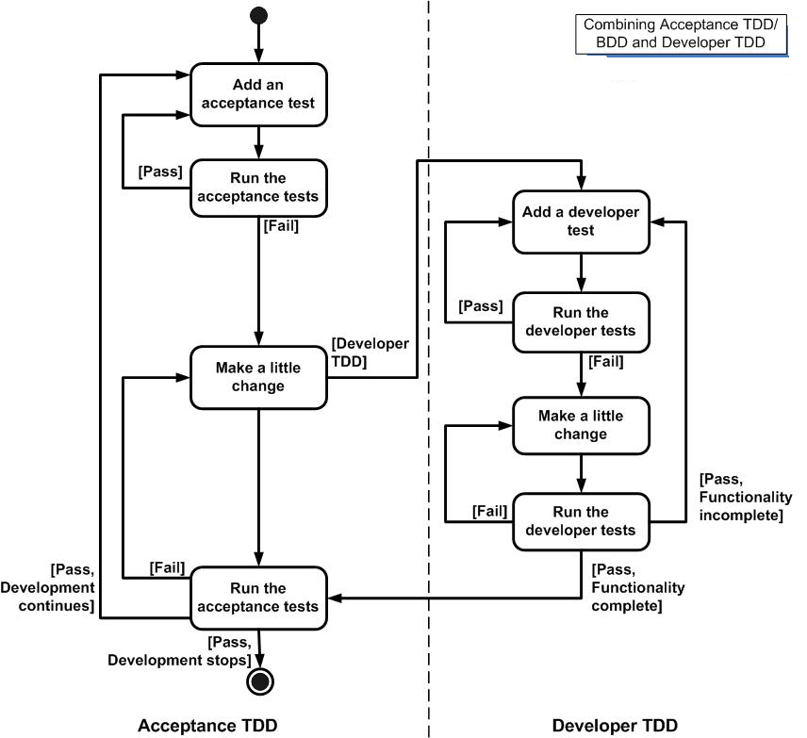
TDD Acceptance Testing

Slide 16
TDD Acceptance Testing
Pick a User story
Write Tests for the story
Automate Tests

Slide 17
TDD Acceptance Testing
User stories should be prioritized based on
  Business Value
  Technical Risk
Discuss with Developers, Testers and Customers on what the customer needs, when and why
This knowledge will be included in the decision of which user story to pick next.

Slide 18
Legacy Code – TDD Approach
TDD assumes that we write tests, then write code and then run the tests.
This approach is not useful for legacy code and we cannot use TDD directly as described earlier.

Slide 19
Legacy Code – TDD Approach
Identify the change point in the legacy code
Identify an inflection point
Cover the identified inflection point
  Break internal dependencies
  Break external dependencies
Write tests
Make changes
Refactor covered code.

Slide 20
Legacy Code - Inflection Points
An inflection point is a point downstream from the change point in your code where you can detect any change in the code’s behavior relevant to your changes.

Slide 21
Legacy code – TDD Approach
As we change the legacy code we will use both the characterization tests and the new-code tests.
New code tests to check that our changes have the intended effect
Characterization tests to check that we do not break any of the behavior that we want to keep

